Slide 1
HEATSAFE
From Prototype to Operating Pilot
Real Texas data, a resident experience that stopped getting in the way, and three agents that run without being asked.
Prepared by Team 5 • CINS 5338/5388 — Software Project Management

Slide 2
Where We Are Now
7
42
3
36
epics
backlog items
AI agents
unit tests
tracked in Jira
all formal user stories
scheduled, not chat
all passing
1
Sprint 1 — AI Priority Matching — is complete and merged
Six stories, twenty-one points, merged to main through a pull request. The scoring engine that makes this more than a directory of addresses was built and proven first, deliberately, rather than saved for last.
The change that matters most
The system no longer runs on invented data. Eleven real relief sites across five Texas counties, every priority score computed from a real heat index and real neighbourhood demographics. Every address on the map is somewhere a person could actually drive to today.
HeatSafe • CINS 5338/5388 — Software Project Management
2

Slide 3
What Changed Since the Checkpoint
R
For residents
ZIP code search, a radius selector that works, and a search that widens itself rather than showing an empty screen.
O
For organizations
A secured portal, invite-based registration, and a priority queue of residents ordered by need.
AI
Three agents
Heat Watch, Dispatch Planner and Site Status Freshness — all scheduled, all explaining themselves.
DB
Real data
Texas pilot region seeded with verified sites; the Los Angeles placeholder set retired.
FE
Front end
Rebuild in React + Vite decided and documented; product renamed to HeatSafe across the UI.
FX
Defects closed
A silently-invalid form field and a scoring threshold that could never fire against real data.
HeatSafe • CINS 5338/5388 — Software Project Management
3

Slide 4
EVERY CHANGE HERE REMOVED SOMETHING THAT WAS IN THE WAY
The Resident Experience
Search by ZIP code
Before: a resident had to type raw latitude and longitude. Now they type the ZIP they already know.
A radius they can pick
Before: a free-text metre field that silently rejected its own default and made Search do nothing. Now: 5, 10, 25 or 50 miles.
A search that widens itself
Eleven sites across a whole state means a tight radius usually finds nothing. Rather than an empty list, the search widens and says how far it had to look.
An honest empty state
When nothing is found it names the five pilot cities instead of saying “no sites match these filters”.
Registration for priority access
An invited resident answers a short intake and immediately sees their priority tier, why, and which nearby sites fit their situation.
HeatSafe • CINS 5338/5388 — Software Project Management
4

Slide 5
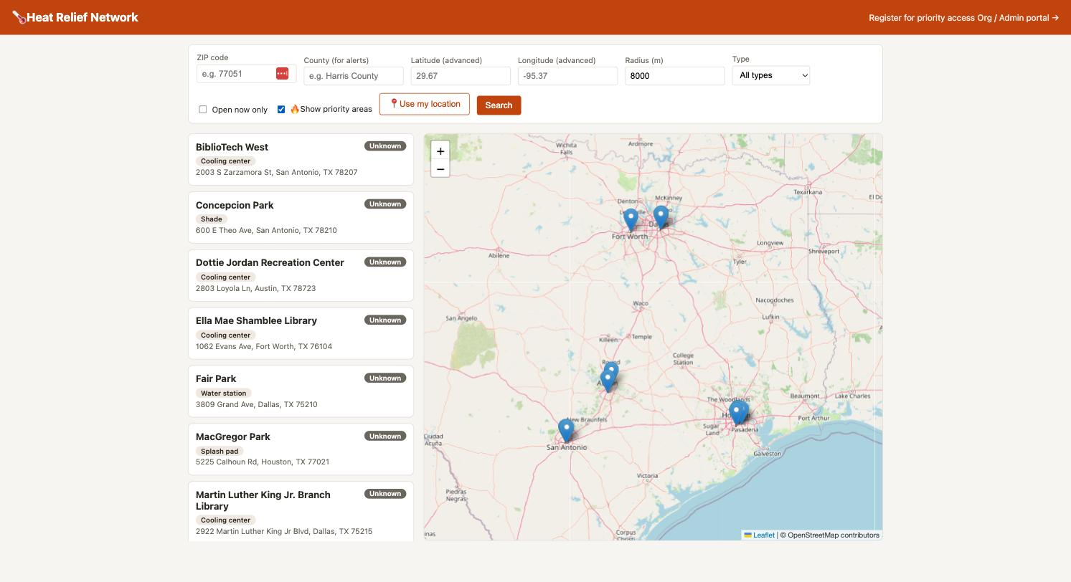
The Resident View, Running on Real Data
What you are looking at
Eleven real relief sites across Houston, Dallas, Fort Worth, Austin and San Antonio.
Library branches serving as cooling centres, recreation centres, parks with splash pads and water stations.
Every address verified against the city's own library or parks department and geocoded through the Census Bureau.
Status reads “Unknown” because real status is set by an organisation that knows — not guessed by us.
Nothing on this screen is invented.
HeatSafe • CINS 5338/5388 — Software Project Management
5

Slide 6
SUBSTANTIALLY MORE CAPABLE THAN AT THE CHECKPOINT
The Organization Portal
Secured
Resident queue
A shared organisation token gates every admin route, compared in constant time. The resident queue holds real people's age, income band, employment and insurance status — it was never safe to leave open.
Registered residents ordered by need score, filterable by tier and city.
Priority areas
Income is never shown
Neighbourhoods ranked by heat vulnerability, adjusted for how far the nearest open site is.
The queue displays a band — below poverty line, below 200% — and the redaction is enforced in the API, not the interface.
Invite codes
Three agents on call
Single-use, eight characters, no ambiguous 0/O or 1/I — so a caseworker can read one down a phone line.
Run on demand from the portal, or on a schedule from cron.
HeatSafe • CINS 5338/5388 — Software Project Management
6

Slide 7
THE DISTINCTION WE DESIGNED AROUND
What We Mean by “Agent”
A chatbot waits to be asked
An agent watches, decides, acts
It has no opinion until a person types something. Useful — but it cannot notice a neighbourhood crossing into danger at two in the morning, because nobody is there to ask it.
It runs on its own schedule, reads the current state of the system, reaches a decision, and changes something or produces a list a person can act on. Nobody prompts it.
All three of ours explain themselves
Every decision carries its reasons in plain language, and the admin portal renders those reasons rather than just the conclusion. This is not decoration. These agents decide who gets contacted first during a heat emergency and where volunteers are sent. An agent that escalates a neighbourhood to “emergency” without showing its working is not something a coordinator should act on — and a system that cannot explain itself cannot be corrected when it is wrong.
No agent contacts a resident directly. Every one of them produces a ranked list for a human to work. That boundary is deliberate.
HeatSafe • CINS 5338/5388 — Software Project Management
7

Slide 8
AGENT 1 OF 3 · RUNS EVERY 30 MINUTES
Heat Emergency Watch
WATCHES
Current heat index and vulnerability score for every pilot area, and whether any open relief site is within five miles.
DECIDES
Maps the heat index onto the National Weather Service bands — advisory, warning, emergency. Escalates one level where an area is BOTH vulnerable AND has no open site nearby: conditions are dangerous and there is nowhere to send anyone.
ACTS
Writes an alert for the county, suppressing duplicates against any active alert of equal or greater severity, and builds a contact list of Tier 1 and Tier 2 residents ordered by need.
Overnight heat that has not broken is called out in the reasons — residents get no recovery window — without inflating the severity on its own.
HeatSafe • CINS 5338/5388 — Software Project Management
8

Slide 9
AGENT 2 OF 3 · RUNS ON DEMAND OVER A 12-HOUR WINDOW
Outreach Dispatch Planner
WATCHES
Volunteer shifts already on the books, neighbourhoods ranked by vulnerability, and every registered resident.
DECIDES
Matches each shift's site to the area it actually serves, then walks areas highest-need first so the most vulnerable neighbourhood gets first claim on volunteer capacity. No resident is assigned to two volunteers.
ACTS
Produces a plan — which volunteer checks on whom, during which shift, at which site — and, more usefully, reports the coverage gaps: high-need areas with nobody scheduled.
It uses the volunteers and shifts tables, which had sat in the schema since the first commit without a single query ever reading them.
HeatSafe • CINS 5338/5388 — Software Project Management
9

Slide 10
AGENT 3 OF 3 · RUNS DAILY
Site Status Freshness
WATCHES
How long ago each site's open/closed status was confirmed, and what the weather is doing in that area right now.
DECIDES
Judges how far a claim can still be trusted. Normally a status ages at 72 hours and expires at seven days; at or above 103°F that tightens to 12 hours and 48 hours. The same claim can be fresh in mild weather and expired during a heat event.
ACTS
Ranks what to re-confirm first by staleness, area vulnerability and heat. Retiring an expired claim is opt-in — it destroys something an organisation entered, so the agent reports and waits.
This one exists because we found the priority engine was being starved: it ranks partly on distance to the nearest OPEN site, but nothing ever asked anyone to keep status current.
HeatSafe • CINS 5338/5388 — Software Project Management
10

Slide 11
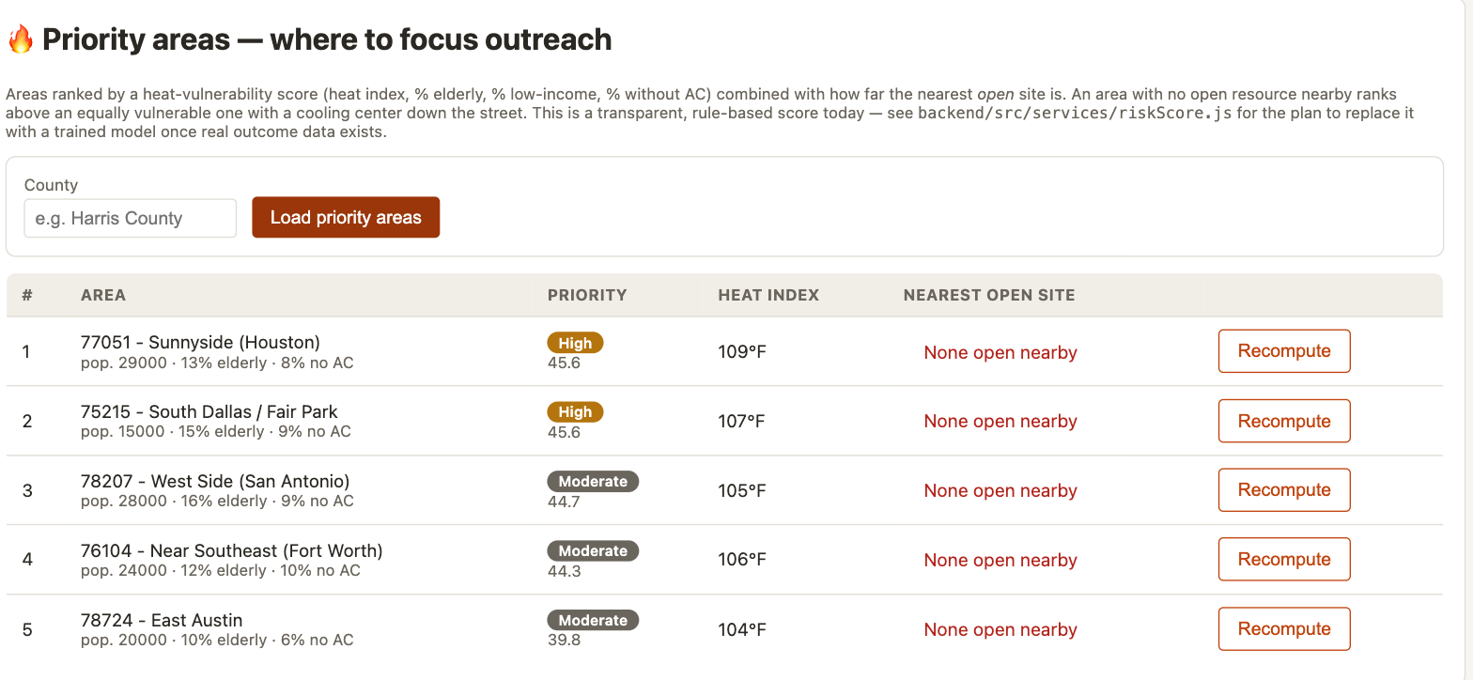
REAL COUNTIES, REAL HEAT, COMPUTED SCORES
What the Organization Sees
Every score here was computed, not entered. “None open nearby” on each row is not a bug — it is the starvation the Site Status Freshness agent exists to fix: the ranking accounts for distance to the nearest OPEN site, and no site has ever been confirmed open.
HeatSafe • CINS 5338/5388 — Software Project Management
11

Slide 12
Behind the Scenes — Backend
API
New endpoints
/api/geocode/zip, /api/invites, /api/residents, /api/agents — covering ZIP lookup, invite issue and redemption, the resident queue and all three agents.
DB
New tables
invites and residents, with spatial indexes; volunteers and volunteer_shifts finally read by something.
SEC
Admin gate
Every organisation-facing route behind a constant-time token check that fails closed rather than falling open.
PRI
Income redaction
Enforced server-side — raw income never leaves the API, only a band.
TST
Test suite
36 unit tests across the scoring engines and all three agents, covering boundaries and missing-data cases.
OPS
Run scripts
Restart and Stop scripts sharing one implementation, plus scheduled runners for two agents.
HeatSafe • CINS 5338/5388 — Software Project Management
12

Slide 13
BOTH FOUND BY WRITING TESTS, NOT BY A USER REPORTING THEM
Two Defects Worth Naming
An absent reading was reported as safe
In JavaScript, Number(null) is 0 — not NaN. So an area with no heat reading at all fell through the checks and was reported as “below caution levels”. In a heat-safety system, absence of a reading is not evidence of safety. It now says exactly that, and a test holds the line.
A threshold that could never fire
The agents used a round 40 as the “this area is vulnerable” line. Our five pilot areas actually score 24.8 to 30.6 — Texas housing is almost universally air-conditioned, so the no-AC factor sits at 6–10% and drags every score down despite carrying 30% of the weight. At 40, neither agent would ever have escalated. They would have looked like they were working while deciding nothing.
Neither would have shown up in a demo. Both would have shown up the first time somebody relied on the system.
HeatSafe • CINS 5338/5388 — Software Project Management
13

Slide 14
42 ITEMS ACROSS 7 EPICS, ALL FORMAL USER STORIES
Where the Backlog Stands
Sprint 1
AI Priority Matching
6 stories · 21 pts
Complete and merged
Sprint 2
Live Weather + Demographic Integration
9 stories · 23 pts
Scoped and assigned
Sprint 3
Priority Access + React migration
8 stories · 39 pts
In review
Sprint 4
Three agent epics
11 stories · 46 pts
In review
Honest status: everything marked In Review is written and unit-tested, but has not yet been exercised against a live database. It becomes Done when we have run it and seen it work.
HeatSafe • CINS 5338/5388 — Software Project Management
14

Slide 15
COMMITTED TO THE BACKLOG, NOT YET STARTED
What's Next
Organization user accounts
SCRUM-53 · ~26 pts
Replace the shared organisation token with per-user logins tied to an organisation. Enables change tracking — who updated which site, who issued which invite — and organisation participation tracking. Passwords hashed with a modern algorithm; the shared token was always documented as a stopgap, and this retires it.
County selector in the header
SCRUM-54 · 5 pts
Today the county sits inside the site-search form beside the ZIP field, and alerts only load when Search is pressed. Two different jobs wearing the same costume. Moving it into the header and loading alerts the moment a county is chosen means a resident sees an active warning without having to search for anything.
Both are scoped with acceptance criteria and development tasks. Neither is started — Sprint 2 comes first.
HeatSafe • CINS 5338/5388 — Software Project Management
15

Slide 16
THANK YOU
F O R Y O U R A T T E N T I O N
HeatSafe • Team 5 • CINS 5338/5388

